Slide 1
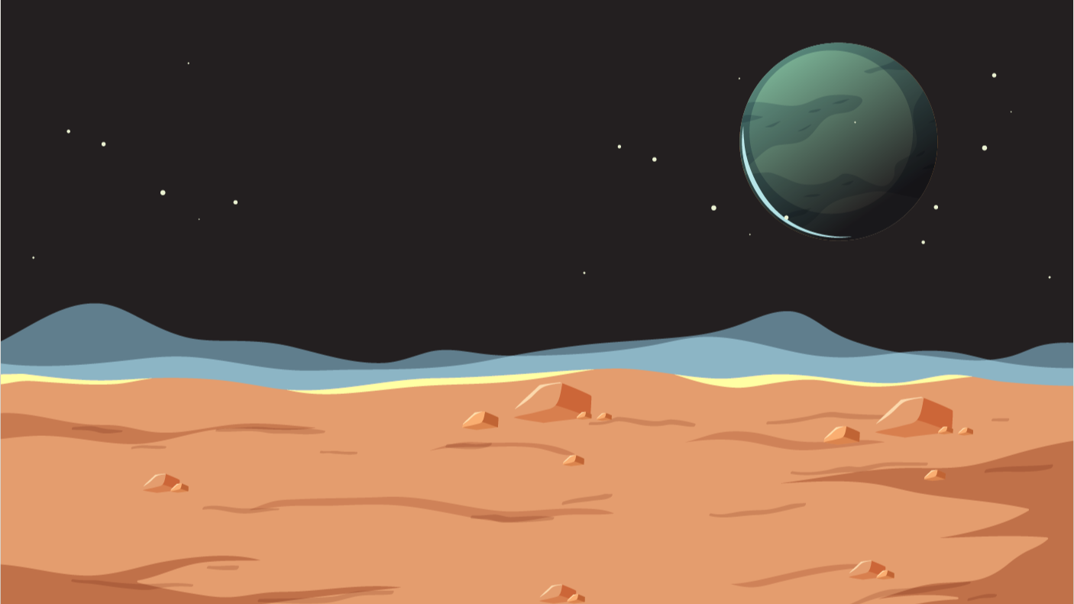

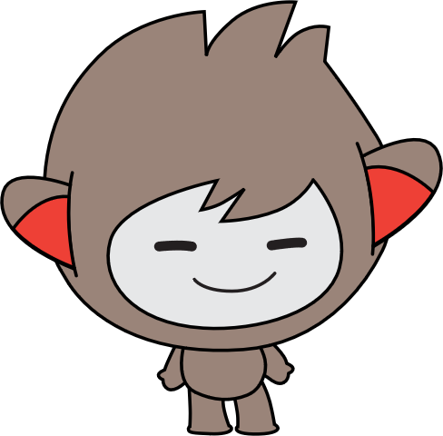


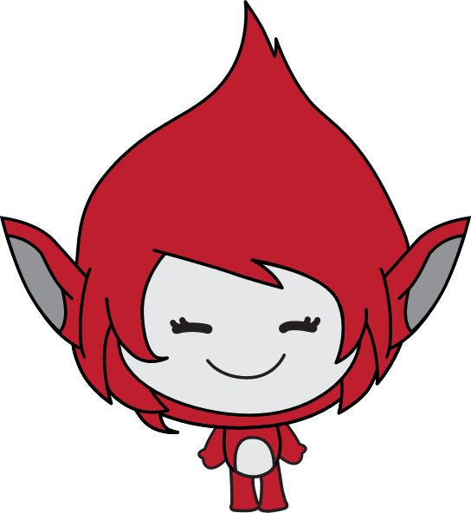
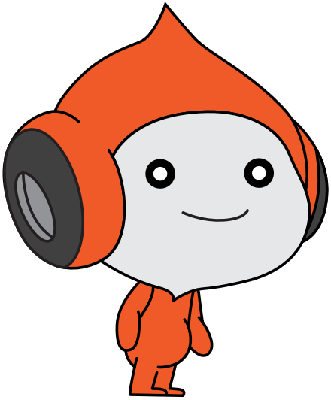
Lesson 1:
space talk

Slide 2
Slide

Slide 3
What we learnt…

Slide 4
Exercises
Have fun with some of the other effects
Try different sprites and backdrops
Say and think differently
Checkout costumes of other sprites
Invent your own way of communication!

Slide 5
Thank you and see you in the next lesson!

